Slide 1




Project: CD3 Prediction using ML
By:
Sankalp Jain
Supervisor: Dr. Ninad Mehendale

Slide 2
Day 1 : Discussion Of Different Models
On Day 1 we discussed about different models that we can apply to our dataset . And decided to choose different model on our choice to experiment on our dataset.
The purpose of experimenting different models was to get sense which model suits our dataset best so that we can proceed further with that model.
Initially I thought we could do ensemble learning and get the model which gives the highest accuracy. But later we decided that we should search for different models that gives a good accuracy and then we will do ensemble learning on that to get the best model.
The model that I tried are as follows:-
Support Vector Regressor (Source)
KNN Classifier(Source)
XG Boost Regressor(Source)
Bayesian Ridge Polynomial(Source)
Linear Regressor Polynomial(Source)
Random Forest Regressor (Source)
Random Forest Classifier(Source)
EXCEL file of the dataset we used:-
Dataset
Difficulties faced and how I overcomed it:
1.I was not to able to find accuracy of regressor model as I was applying accuracy metrics on regressor models instead of using MSE,MAE.

Slide 3
DAY-2 : Exploring New References
I tried to explore different repositories and kaggle notebooks showing predictions of covid 19 cases.
Tried to get insight about what more models we should try from the Kaggle winning notebooks and github repositories.
Tried to understand whether classification models fits our dataset or regression models fits our dataset.
Tried to explore new techniques that we should include in our project ,so that we can increase the accuracy of models by observing notebooks.
Difficulties faced and how I overcomed it:-
I was predicting on whole data which was wrong . Mahesh Sir told me that I should split the whole data in train and test instead of using the whole data for predictions.
I was using using the same data which I used in fitting in prediction as well which was giving error which Mahesh Sir pointed out and then I corrected the mistake by using train data in fitting and used test data for prediction.
References:-
https://github.com/therealcyberlord/coronavirus_visualization_and_prediction/blob/master/coronavirus-covid-19-visualization-prediction.ipynb
https://www.kaggle.com/sulianova/covid-19-forecasting-with-random-forest
https://www.kaggle.com/c/covid19-global-forecasting-week-4/notebooks
https://www.researchgate.net/publication/341170227_Accurate_Classification_of_COVID-19_Based_on_Incomplete_Heterogeneous_Data_using_a_KNN_Variant_Algorithm

Slide 4
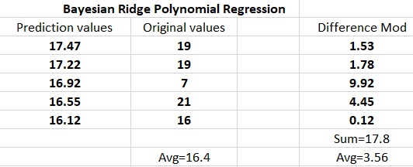
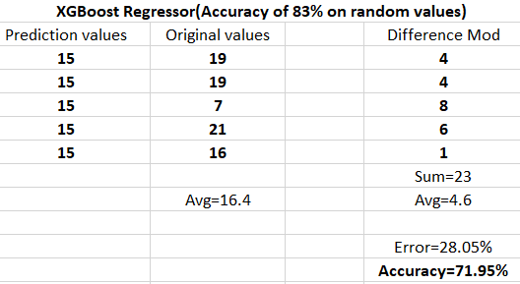
DAY 3 : IMPLEMENTED DIFFERENT ALGORITHMS
Implemented all the algorithms to see accuracy for predictions of Covid-19 cases for next five days and verified the predictions with the actual patients for nest five days for all models.
I implemented all the models that I showed in the first slide. And this is the link of colab notebooks where I have implemented all the models.
Colab Notebook:-https://colab.research.google.com/drive/1lAWjARLEhH7AIER_CwOEhOmiKUv3Ls4L?usp=sharing
Below I will show accuracy tables of models showing high accuracy on our dataset.
The accuracy tables for remaining models that I tried is in following excel file:
Accuracy
Issues: Not able to get good accuracy for the dataset.

Slide 5
Day 4 : Dealing with the low accuracy of models
I tried to find accuracy of our models by predicting Covid-19 cases for next five days and the highest accuracy I got was 78.93% on Baysian Ridge Polynomial Regressor which was not good.
So as per suggestion of Mahesh Sir we tried to predict Covid-19 cases on initial five days to see what accuracy it gives but it was not giving good prediction and error was more than 100%.
And when again I tried to predict Covid-19 cases on random days than I was able to achieve accuracy of 83% on XGB regressor model which had only accuracy of 71.95% for predicting the cases for next five days.
But this was also not good as we want accuracy of more than 95% for our project as it for critical issue and error in prediction is not tolerable.
Results:
Accuracy of 78.93% for Bayesian Ridge Polynomial Regressor model for prediction of cases on next five days.
Accuracy of 83% for XGBoost model for prediction of cases on any random days.
Issues:
Getting different accuracy for prediction on next five days and for prediction on random days.
Like XGB regressor was giving accuracy of 71.95% for prediction on next five days but it gave accuracy of 83% on prediction on random days. Don’t know why such fluctuation is happening.
When I tried for prediction on initial five days all models are giving error more than 100% .
I think we need more data to get a good predicting model.
I think there is problem with the dataset.

Slide 6
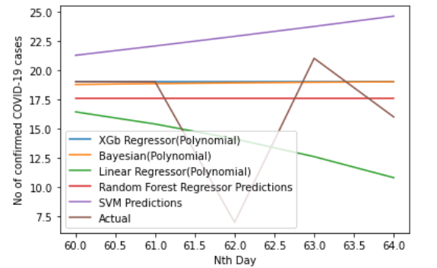
Day-5 : Search for new dataset
As I was not getting good accuracy for out current dataset . Mahesh Sir suggested me that I should find some other dataset on try to get accuracy of my models on that dataset.
The datasets I found can be found on this link.
After this Mahesh Sir told that I should try to get dataset of Maharashtra specifically as the cases are mostly in Maharashtra and he said in particular I should try to get dataset of some hospital.
Issues:
Problem with dataset available , as it is not giving good accuracy .
Want more data as our dataset have only 60 days information.
Not able to get dataset of other hospital on internet as it is confidential.
What we decided :-
As we were not able to get some other hospital dataset we than decided to stick with the old dataset that we were provided and we will try to accuracy on that dataset only.
The following graph shows the difference in prediction of our model from actual predictions for predicting the cases for next five days:-

Slide 7
Day 8 : Looking For A New Dataset
As I was not getting good results on previous dataset so I looked for the new dataset which can be found here.
It was dataset of covid-19 cases in India as of now and it had 145 entries.
I pre-processed the dataset and made it ready to train on all models.
I ran all models on these datasets and I got following values of MAE and MSE.
Model Name | MAE | MSE
Support Vector Regressor (SVR) | 23866.4993 | 1108871082
Random Forest Regressor | 2282.704 | 16036121.94
Polynomial Linear Regressor | 937.8686 | 1563399.613
Bayesian Ridge Polynomial Regressor | 997.1067 | 1894548.005
XG Boost Regressor | 3869.8103 | 35788863.54
Issues and how I overcome it:-
You can see the problem with these MAE and MSE values. They are very large which is very bad for our problem statement.
Later I found why I am getting large values for MAE,MSE, the reason was that instead of having number of confirmed covid-19 cases for each day in dataset instead I had number of confirmed covid-19 cases till date in dataset.
So these was the reason for such large values of MAE and MSE.
So we decide to change our dataset where we could get number of confirmed covid-19 cases for each day.

Slide 8
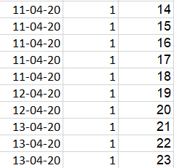

DAY-9 : Failure of the dataset and selection of new dataset
As there was problem with the previous dataset I started working on new dataset founded by Aman and pre-processed by Jash .
In these dataset there was problem which I resolved by using KUTOOLS FOR EXCEL and by following a article.
The problem was that there was a new row for every new patient confirmed for covid-19, even for the same day like seen in the image attached below.
We wanted individual row for every day consisting of total no of covid-19 of that day instead of having new row for every new confirmed covid-19 patient.
Before pre-processing After pre-processing
References:-
https://www.extendoffice.com/product/kutools-for-excel.html
https://www.extendoffice.com/documents/excel/3457-excel-sumif-same-date.html

Slide 9
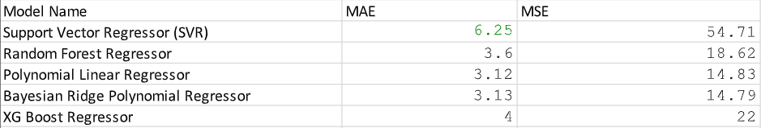
DAY 10 : Calculated MAE,MSE Values for all models
Now as our dataset was ready, I ran all the models and calculated MAE,MSE values of all the models.
Before I was running models without setting random-state in train-test split because of which I got different values of MAE ,MSE whenever, I started runtime of the file again. As train-test split method give different sample every time I run it.
This problem was overcome by setting random-state to 1 in train-test split method which ensured that I get same results whenever I start my runtime again or load the train-test split method again and again.
Which results in consistency of results and this avoid confusion of getting different result when I start runtime again or load the file.
The excel file having MAE,MSE of all models can be found here.
Issues:
Not able to reduce MAE and MSE values.

Slide 10
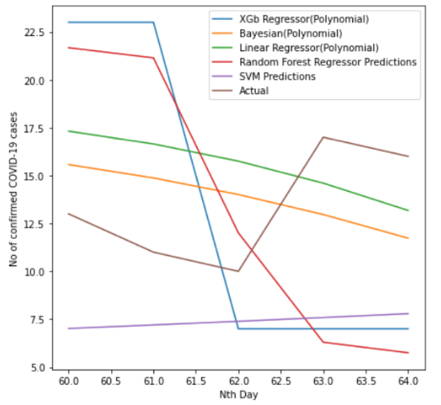
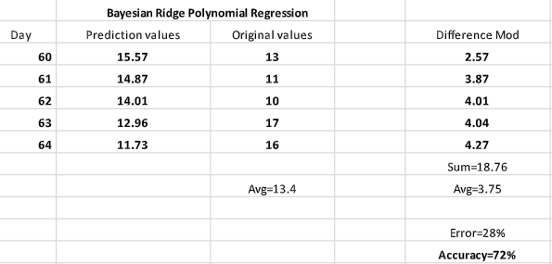
Day-11: Calculating accuracy for prediction of covid-19 cases on 60,61,62,63,64th day
After calculating MAE,MSE values, I calculated accuracy for prediction of covid-19 cases on 60,61,62,63,64th day
The codes for all models can be found in these Colab file.
The calculations of accuracy can be found out in these excel file.
Difference of prediction of all models from actual data Model showing highest accuracy among all models
Issues:
Not able to achieve good accuracy.
Dataset is skewed.
Not enough data for machine to learn (underfitting).

Slide 11
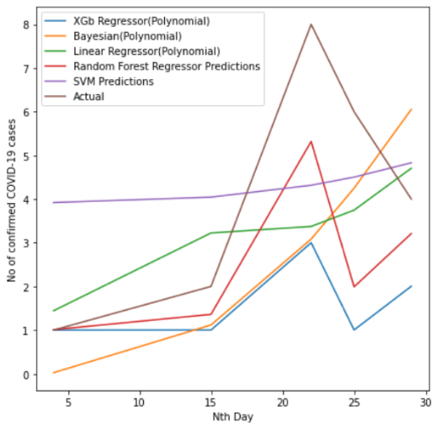
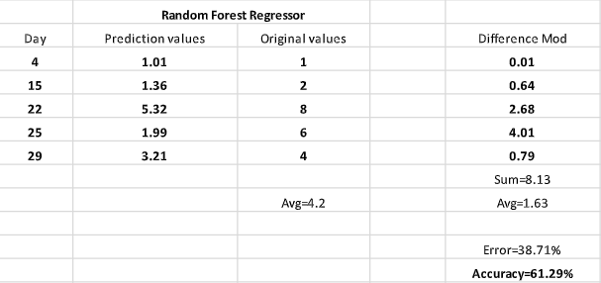
Day-12: Calculating accuracy for prediction of covid-19 cases on 4,15,22,25,29th day
After calculating accuracy prediction of covid-19 cases on 60,61,62,63,64th, I calculated accuracy for prediction of covid-19 cases on 4,15,22,25,29th day in the hope of getting more accuracy.
I followed this strategy to see whether the results get improved on prediction of random data, as sometimes data is skewed.
The codes for all models can be found in these Colab file.
The calculations of accuracy can be found out in these excel file.
Difference of prediction of all models from actual data Model showing highest accuracy among all models
Issues:
Not able to achieve good accuracy.
Dataset is skewed.
Not enough data for machine to learn (underfitting).

Slide 12
Day 15 : Change of dataset
As we were not getting good accuracy on the dataset of hospital , sir told us to look for dataset for 15 different countries of daily confirmed covid-19 cases.
The dataset for 15 different countries was found out by Aman.
I was given 6 different countries for which I had to pre-process the data. Software used for pre-processing Kutools for excel
The need to pre-process the data was because the dataset had new row for every new patient admitted even on the same day
But we needed total number of patients admitted on each day on each row instead of having new row for every new patient admitted.
The datasets provided to me can be found on the link given below.
Datasets Before Pre-processing (Link) Datasets After Pre-processing(Link)
References:-
https://www.extendoffice.com/product/kutools-for-excel.html
https://www.extendoffice.com/documents/excel/3457-excel-sumif-same-date.html

Slide 13
DAY-16: Finding accuracy of all models on datasets of different countries
After pre-processing the dataset now I had to find accuracy of all models on datasets of all countries.
I had to find accuracy for prediction of covid-19 cases on any particular day for all models.
But as I was going to run all models on the datasets, sir told that we should not select any random countries for predictions.
Sir told we should select countries having highest population and having highest density.
So I scraped all the datasets.
Meanwhile I learnt new software for getting datasets from images.
The software name was WebPlotDigitizer (This software simply converts screenshots to datasets) which could be used to get datasets of any country from their covid-19 plots.
So instead of doing pre-processing to get total no of confirmed covid-19 cases of every day using Kutools for excel we could I directly get dataset having total no of confirmed covid-19 cases of every day by using this tool for analyzing.
References:-
https://www.youtube.com/watch?v=P7GbGdMvopU&feature=youtu.be
https://apps.automeris.io/wpd/

Slide 14

DAY 17 : Countries having high population and high density
Aman found out the countries having high population and high density.
I collected datasets of Pakistan , Bangladesh, Nigeria from the excel file having confirmed covid-19 cases for all the countries of the world.
The Excel having confirmed covid-19 cases for all the countries of the world can be found in these link.
The Excel files for Pakistan , Bangladesh , Nigeria can be found in this link.
Now after getting datasets I had problem like what should be start and end date for our dataset, as different countries had different date when the outbreak started in their country.
So I could not have uniform start date for all datasets but I could have have uniform end date for all datasets.
So now number of datapoints were now different countries and we would not have same number of datapoints.
And another problem was that the datasets was not continuous in some places, like in someplace it had 6 June directly after
1 June which was not acceptable as then the model would not predict correctly.
So now I decided to collect the dataset from the date that had continuous values till the end date without missing any dates in between.
Dataset having missing dates in between

Slide 15
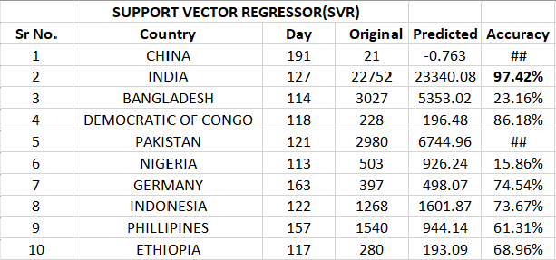
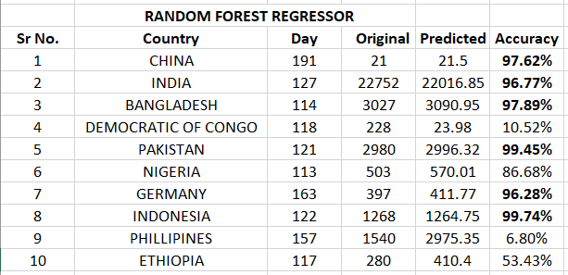
Day 18 : Making predictions for all dense and populated countries
Now after overcoming the problems of datasets I decided to make prediction for the last date, as it would help me even to calculate the accuracy of predictions.
So I deleted the data of last date of all the datasets and predicted the confirmed covid-19 case for that date using models and then measured accuracy of all models.
The source code for all model can be found in this link.
The excel files of accuracy of all models can be found in these link.
I had made predictions of all datasets on SVR , XGBoost Regressor , Linear Regressor(Polynomial) , Bayesian Ridge Regressor , Random Forest Regressor which can be found below:-

Slide 16
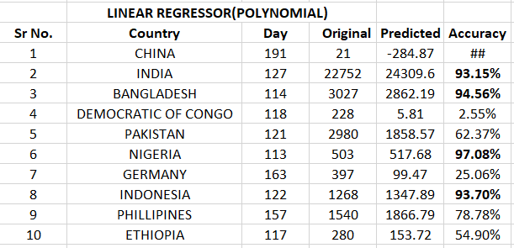
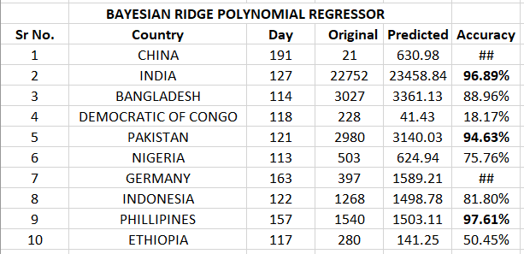
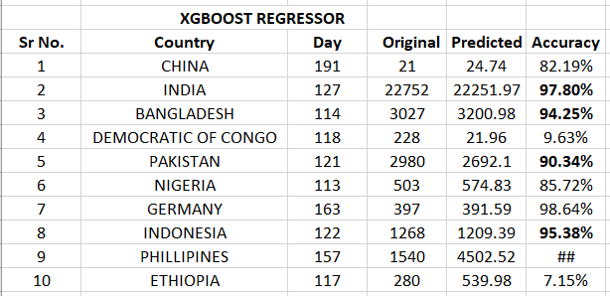
Day-19 : Making predictions for all dense and populated countries

Slide 17
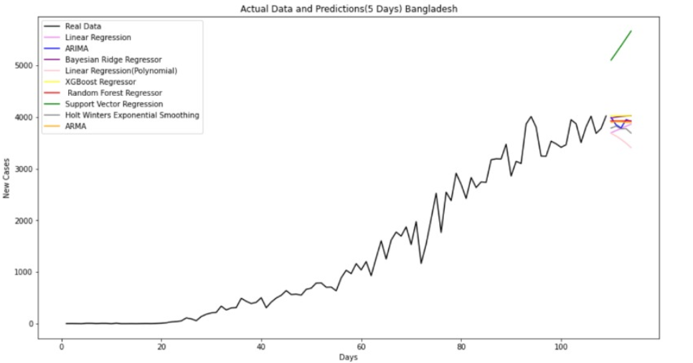
Day 22 : Graphs And Visualizations
Now I have started working on making graphs for the countries that were allotted to me.
The code for the graphs and visualization can be found in this notebook.
The visualizations and graphs that I made are as follow
And the datasets required for making this visulizations can be found in this link.

Slide 18
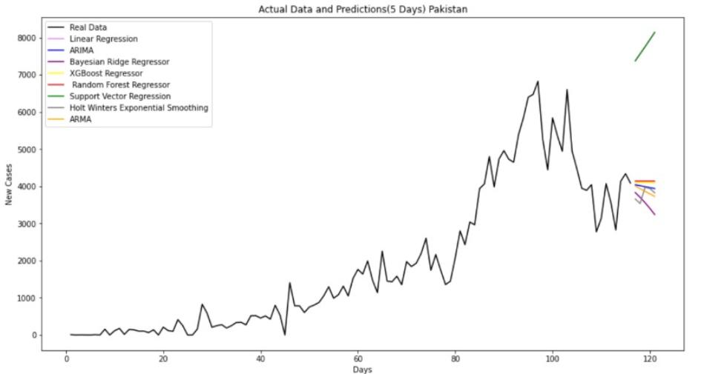
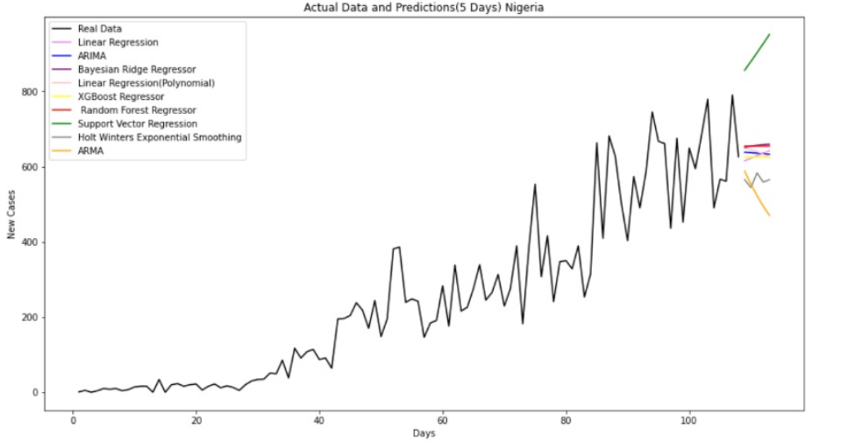
DAY-23 : Graphs And Visualizations

Slide 19
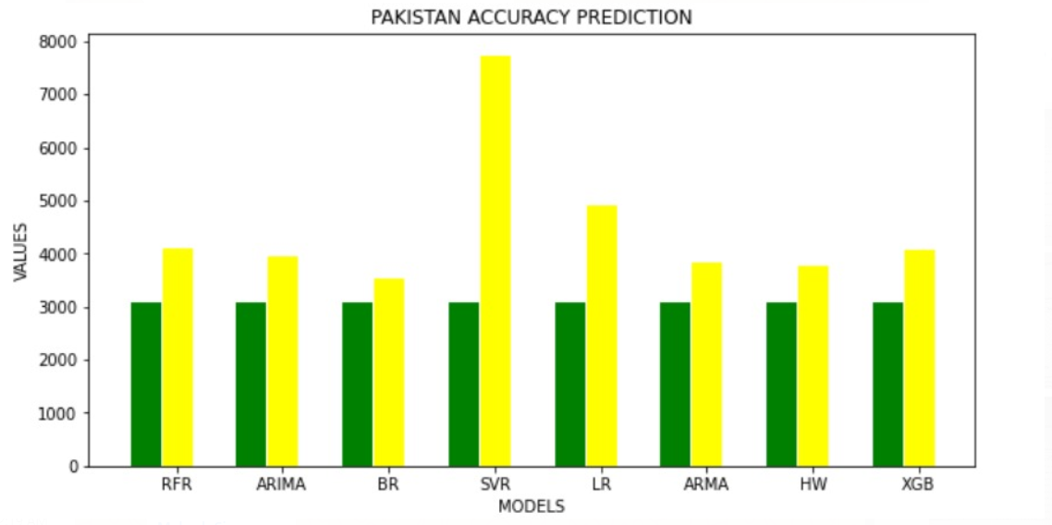
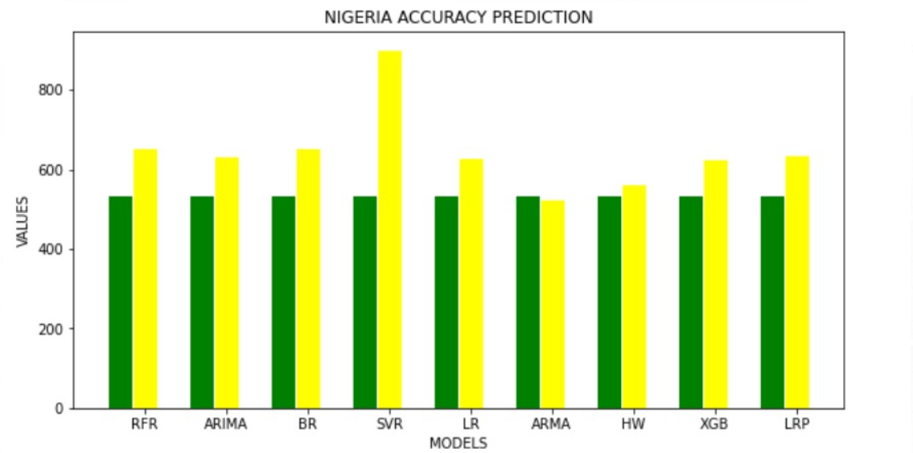
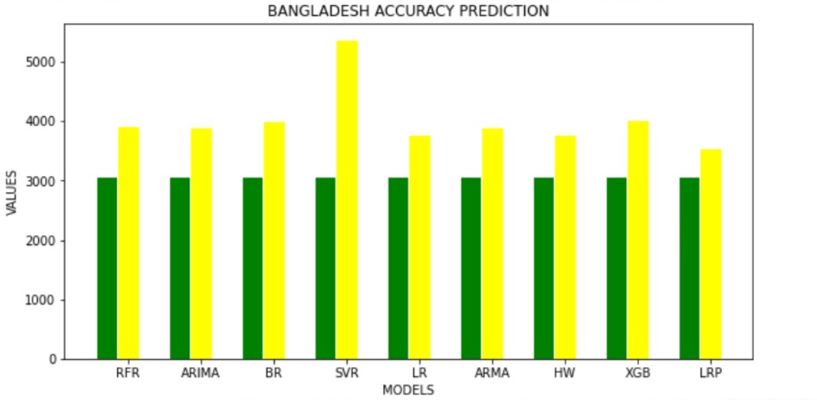
DAY 24 : Graphs And Visualizations

Slide 20
Day-25 : Methodology And Supplementary
Now after the graphs were done and improved by graphics team, I started writing methodology for models that I had been working on throughout this project for the manuscript.
The methodology that I wrote before correction can be found in these link.
The methodology after correction from team can be found in these link.
I wrote supplementary for my models and Aman models and Jash wrote the supplementary of his models. The entire supplementary can be found in these link.

Slide 21
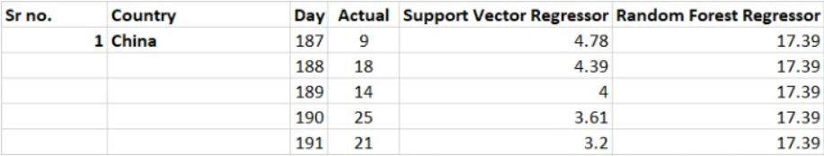
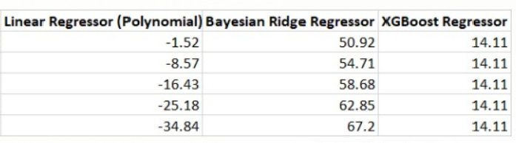
Day-26: Recalculation Of China Predictions
As we were getting negative values for China’s prediction, I recalculated China’s prediction after removing the skewed dataset as advised by Aman.
I removed the part of dataset that had high values than the entire dataset which lead negative results as advised by Aman and I was able to achieve positive predictions for 4 out of 5 models that I was working on in these project.
The prediction of all models after removing skewed dataset can be found below:-

